Slide 1
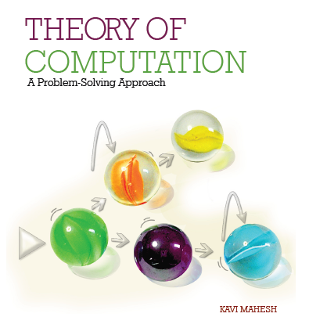

Theory of Computation: A Problem-Solving Approach
Chapter – 11: The Chomsky Hierarchy

Slide 2
Learning Objectives
Learn the difference between countably infinite and uncountably infinite sets.
Learn the diagonalization technique to show that a language is uncountable.
Learn how to properly enumerate a language.
Learn why some languages are not enumerable.
Understand the difference between acceptance and membership in a language.
Understand why some languages are enumerable but not recursive.
Learn to construct a context-sensitive grammar for a language.
Learn to construct a pushdown automaton with two stacks.
Learn how unrestricted grammars work.
Learn how linear-bounded automata work.
Learn how all formal languages can be arranged in the Chomsky Hierarchy.

Slide 3
Languages, Grammars and Machines
What class of languages corresponds to Turing machines?
Recursively Enumerable Languages
What kind of grammars are equivalent to Turing machines?
Unrestricted Grammars
Are there languages beyond the languages of Turing machines?
Yes!
If Turing machines are the most powerful computing devices, are there classes of languages in between CFLs and those of Turing machines?
Yes, context-sensitive languages
Are there types of computer memory more powerful than a PDA’s stack but less powerful than a Turing machine’s tape that correspond to these intermediate languages?
Yes

Slide 4
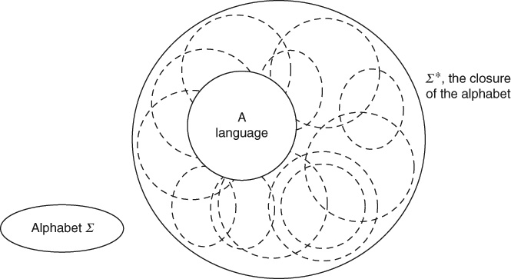
Counting Alphabets and Languages

Slide 5
The Idea of Enumeration
Given a set, possibly infinite, can we list, i.e., enumerate its elements in some order so that any given finite element of the set is listed in finite time?
Such a listing is called proper enumeration
E.g., list in increasing order of length first, and, within strings of the same length, order alphabetically
Two sets have the same cardinality if their elements can be mapped one-to-one and onto

Slide 6
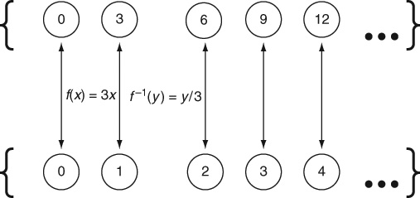
Countably Infinite Sets
There are as many numbers divisible by 3 as there are integers!

Slide 7
Uncountably Infinite Sets
Not all sets can be mapped to the set of integers
Real numbers are uncountably infinite
Proof by contradiction: Cantor’s diagonalization
Assume that real numbers are enumerable
Invert the diagonal to create a number that is different from all enumerated numbers
But all numbers were already enumerated
Contradiction: therefore real numbers cannot be enumerated; they are uncountably infinite

Slide 8
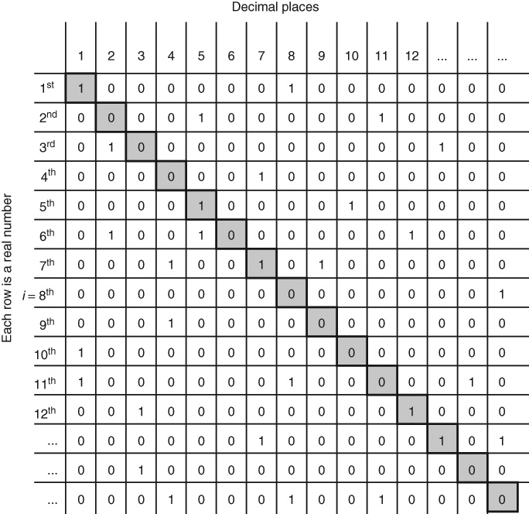
Real No.s are Uncountable: Diagonalization

Slide 9
Set of All Languages is Uncountable
Set of all strings over a finite alphabet is countably infinite
Set of all subsets of all strings, i.e., set of all formal languages over a finite alphabet is uncountably infinite
There are “as many” strings as there are integers
There are “as many” languages as there are real numbers
How many formal languages are there over an alphabet Σ? This is the number of subsets of Σ*, or, in other words, the size of the power set 2^{Σ*}
Diagonalization used to show this by contradiction

Slide 10
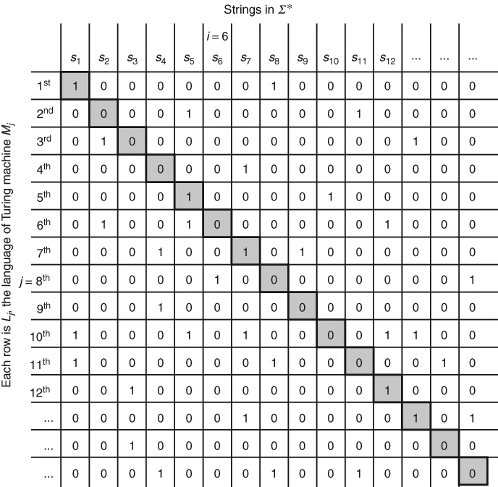
Diagonalization for Languages

Slide 11
Diagonal Languages
The diagonal language L_{Diag} = {s₁, s₅, s₇, s₁₂, s₁₃, …}
Its complement L_{Non-RE} = {s₂, s₃, s₄, s₆, s₈, s₉, s₁₀, s₁₁, s₁₄, s₁₅, …}
This language has something different from every other language!
If a language L_{i} (of the ith Turing machine) contains the string s_{i}, the language L_{Non-RE} does not contain it.
If L_{i} does not contain s_{i}, then surely L_{Non-RE} contains it.
L_{Non-RE} is not recursively enumerable

Slide 12
Turing Machines are Countably Infinite
Every Turing machine can be encoded as a binary string (see Chapter 10) but not every binary string is a Turing machine
There are only countably infinite binary strings
There are only countably infinite Turing machines (i.e., algorithms or all possible computer programs!)
But there are uncountably infinite formal languages
Thus, there are “many more” languages than there are Turing machines to accept them!
There must be languages that cannot be accepted by any Turing machine!
There are formal languages that are not recursively enumerable

Slide 13
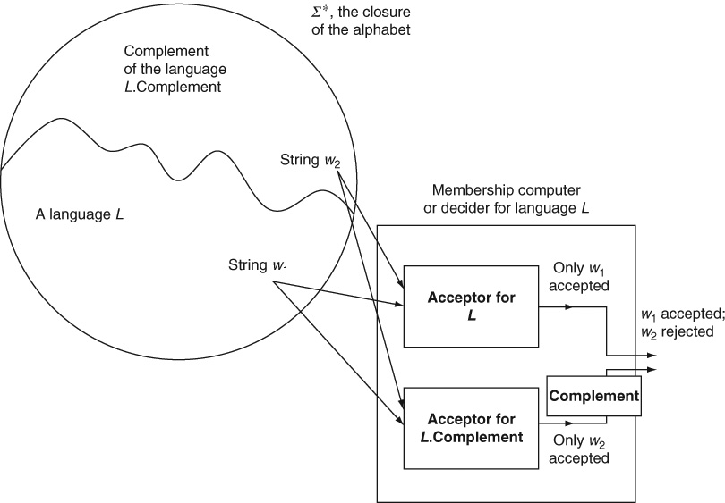
The Ideas of Acceptance and Membership

Slide 14
Acceptor and Decider Machines
Given a string that belongs to a language as input, an acceptor machine for the language accepts it
Given a strings that does not belong to the language, there is no guarantee that it rejects the string (because of the halting problem of Turing machines, see Chapter 12)
For every recursively enumerable language, there is a Turing machine acceptor
If the acceptor for a language also rejects every non-member input string, it is called a decider machine which computes the membership function for the language
Such a language which has a decider machine is called a recursive language
Every recursive language is recursively enumerable but not vice versa

Slide 15
The Hierarchy thus far
Not all formal languages are recursively enumerable; those that are, are countably infinite and correspond to an enumeration of all possible Turing machines.
A proper subset of recursively enumerable languages, known as recursive languages, has membership functions and decider machines.
The complement of every recursive language is also recursive but the complement of a recursively enumerable language that is not recursive is not recursively enumerable.
We know all of the above from the diagonalization argument.
Every context-free language (and therefore every regular language) is a recursive language but not every recursive language is context-free.

Slide 16
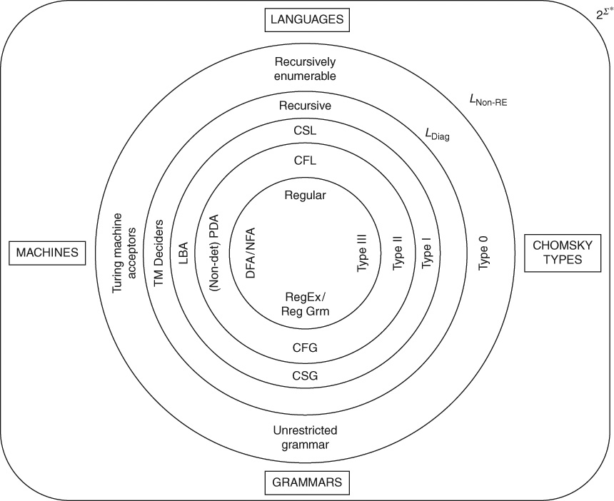
Chomsky Hierarchy

Slide 17
Context-Sensitive Languages
Are there recursive languages which are not context-free?
Is there any interesting class of languages in between context-free and recursive languages?
What if a language is not context-free?
Are there machines more powerful than PDAs but less powerful than Turing machines?
Do such machines correspond to an intermediate class of languages?

Slide 18
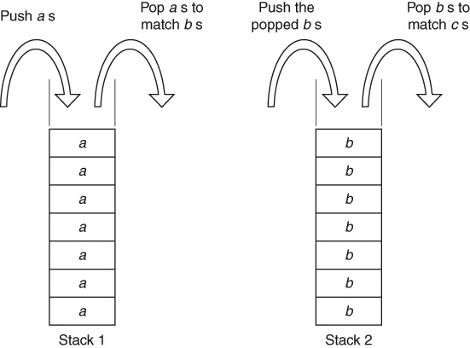
PDA with 2 Stacks for a^{n}b^{n}c^{n}

Slide 19
Context-Sensitive Grammar: Example 11.1
A context-sensitive grammar for the language of a^{n}b^{n}c^{n}
Can we write a grammar by relaxing the restriction that the left-hand side of a production must be a single variable?
Can we somehow construct grammars in which variables can run around in the string (i.e., sentential form) and insert required symbols at the right places, the same way that the reading head of a Turing machine moves back and forth along its tape?
S → abc | aAbc
Ab → bA
Ac → Bbcc
bB → Bb
aB → aaA | aa
Note: A context-sensitive grammar cannot use a shrinking lambda production for convenience. The grammar shown in the book has been rewritten above without the lambda rule.

Slide 20
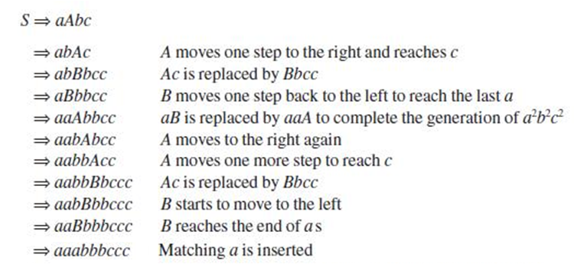
Example 11.1: Derivation of a³b³c³

Slide 21
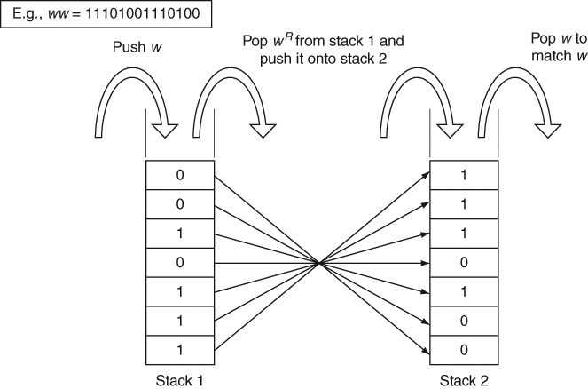
CSG for ww: Example 11.2

Slide 22
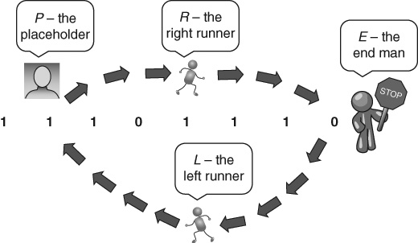
CSG: Messenger Variables or Runners

Slide 23
Runner Variables
P and Q are placeholders that mark the points where symbols are being inserted into the first part of the sentential form.
R and T are the “right runners” that go till the end of the sentential form.
E is the “end marker” to stop the “right runners” so that they can insert the corresponding symbol in the second part of the sentential form.
L and M are the “left runners” that come back to the placeholder. Right and left runners are also known as “messenger variables.”

Slide 24
Grammar: Example 11.2
Note: This uses shrinking, lambda productions for convenience. As such, this is really an unrestricted grammar, not a context-sensitive grammar!
S → 0V0E | 1V1E | λ
V → 0PR | 1QT | λ
R1 → 1R
R0 → 0R
RE → L0E
0L → L0
1L → L1
PL → VL
L → λ
E → λ

Slide 25
Grammar for Example 11.2 (contd..)
The rules for Q and T are similar to those for P and R:
T1 → 1T
T0 → 0T
TE → M1E
0M → M0
1M → M1
QM → VM
M → λ

Slide 26
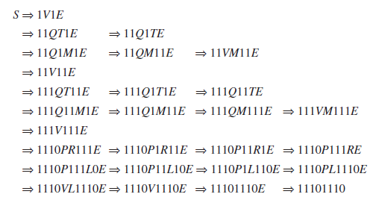
Example 11.2: Derivation of 11101110

Slide 27
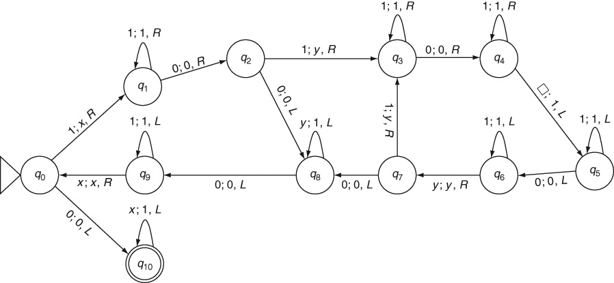
Turing Machine (LBA) for Multiplication

Slide 28
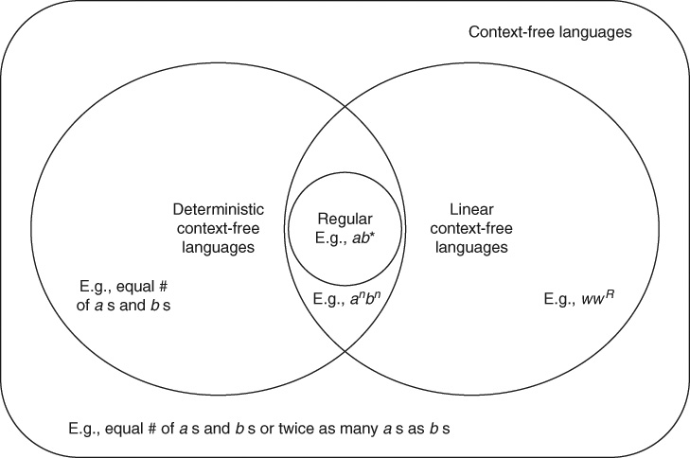
Linear and Deterministic CFLs

Slide 29
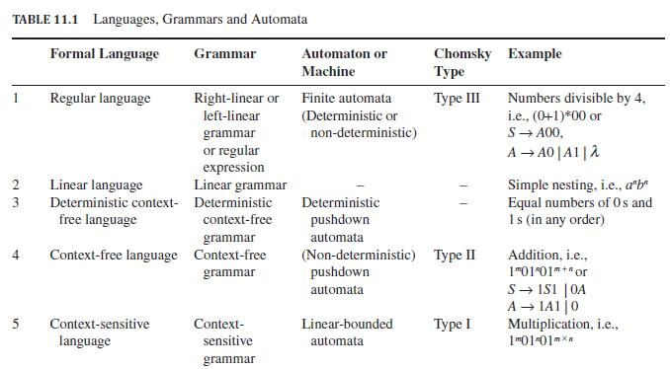
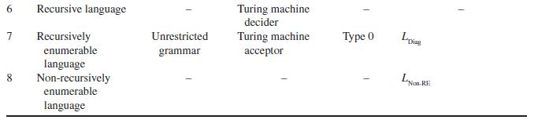
Languages, Grammars and Automata

Slide 30
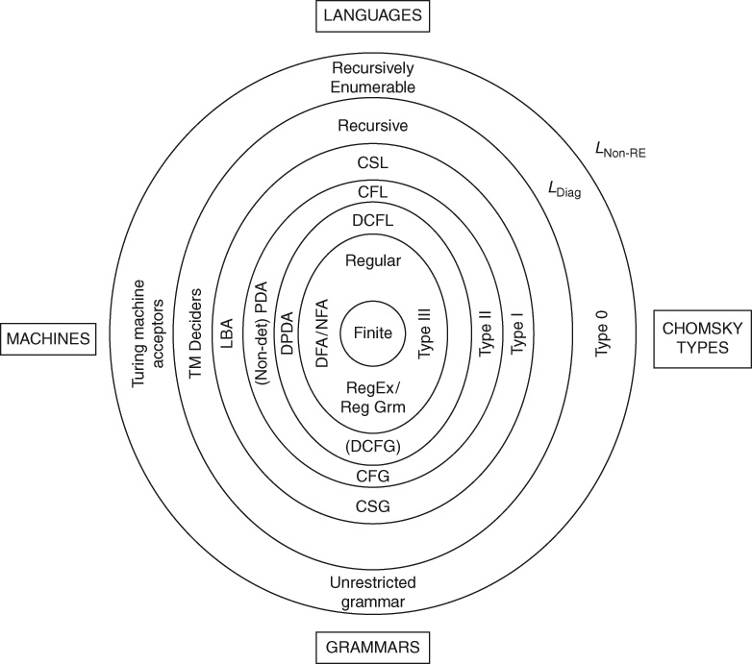
Complete Chomsky Hierarchy

Slide 31
Theorems
Theorem 21: Countability of Turing Machines: The set of all possible Turing machines is countably infinite.
Theorem 22: Uncountability of languages: The set of all formal languages over a given non-empty alphabet is uncountably infinite.
Theorem 23: Existence of Non-RE languages: There are formal languages that are not recursively enumerable; there are formal languages for which no Turing machine acceptor exists.
Theorem 24: Recursive languages are a proper subset of RE languages: Every recursive language is recursively enumerable; there exist recursively enumerable languages that are not recursive.
Corollary 24.1: There are recursively-enumerable languages whose complements are not recursively enumerable.
Corollary 24.2: If a language and its complement are both recursively enumerable then they are both recursive.

Slide 32
Theorems (contd..)
Theorem 25: Context-sensitive languages are a proper subset of recursive languages: Every context-sensitive.
Theorem 26: Context-free languages are a proper subset of context-sensitive languages: Every CFL is context-sensitive; there exist context-sensitive languages that are not context-free.
Theorem 27: Deterministic CFL is a proper subset of CFL: Every deterministic CFL is context-free; there exist context-free languages that are not deterministic.
Theorem 28: Linear languages are a proper subset of CFL: Every linear CFL is context-free; there exist context-free languages that are not linear.
context-sensitive language is recursive; there exist recursive languages that are not

Slide 33
Theorems (contd..)
Theorem 29: Regular languages are a proper subset of both DCFL and of Linear: Every regular language is both deterministic and linear (and therefore context-free); there exist DCFLs that are not regular; there are linear languages that are not regular.
Theorem 30: Finite languages are a proper subset of regular languages: Every finite language is regular; there exist regular languages that are not finite.
Theorem 31: Equivalence of linear-bounded automata and context-sensitive languages: For every context-sensitive language, there is a linear-bounded automaton that accepts the language. Conversely, the language accepted by every linear-bounded automaton is a context-sensitive language.
Theorem 32: Equivalence of Unrestricted grammars and RE: The language of every unrestricted grammar is a recursively enumerable language. Conversely, for every recursively enumerable language, there exists an equivalent unrestricted grammar.

Slide 34
Key Ideas
Turing Machines correspond to the class of formal languages known as recursively enumerable languages and the class of grammars known as unrestricted grammars.
The largest formal language over a given alphabet is the *-closure of the alphabet Σ*, a regular language. All other languages, however complex, are subsets of this simple language.
Any set or language whose elements can be mapped one-to-one to the set of natural numbers is said to be countably infinite.
Strings in any infinite language are countably infinite.
Not all infinite sets are countably infinite. A set such as the set of all real numbers is uncountably infinite.
Uncountability of sets is demonstrated using the technique of diagonalization. This is a proof by contradiction in which a new element of the set is constructed from the diagonal of a matrix. The newly constructed element is different from all the enumerated elements of the set, thereby showing that the set is not enumerable.
Any set that is recursively enumerable has a proper enumeration procedure whereby any given element of the set can be enumerated or listed in finite time.

Slide 35
Key Ideas (contd..)
Turing Machines are countably infinite since they can all be encoded as binary strings. Recursively enumerable languages are also countably infinite.
The set of all languages over an alphabet is uncountably infinite. There are more languages than there are Turing Machines to accept them. Not all languages are recursively enumerable. Not all languages are computable.
Recursively enumerable languages whose complements are also recursively enumerable are called recursive languages. The complement of a recursive language is also recursive.
Recursively enumerable languages have Turing Machine acceptors that accept any string in the language. Recursive languages have Turing Machine deciders that compute the membership function for the languages. They accept all strings in the language and reject all strings that are not in the language.
Finite languages are a proper subset of regular languages since every finite language is regular but not every regular language is finite.

Slide 36
Key Ideas (contd..)
Regular languages are a proper subset of context-free languages. Every regular language is context-free but not vice versa. A finite automaton for a regular language is nothing but a pushdown automaton that never uses its stack. On the other hand, not every context-free language is regular; this has been shown using the Pumping Lemma for regular languages.
Context-free languages are a proper subset of context-sensitive languages. Every CFL is a CSL because its context-free grammar is nothing but a context-sensitive grammar in which every production happens to have only a single variable on its left-hand side. Not every CSL is context-free as can be seen by applying the Pumping Lemma for context-free languages.
Context-sensitive languages are a proper subset of recursive languages. Every context-sensitive language is recursive since a linear-bounded automaton for a CSL is actually a decider Turing machine for the language. However, not every recursive language is a context-sensitive language as can be shown by applying the diagonalization technique.
Context-sensitive languages are the languages of context-sensitive grammars which follow the non-shrinking rule: every production rule must have a right-hand side that is at least as long as the left-hand side so that sentential forms do not shrink during a derivation.

Slide 37
Key Ideas (contd..)
Recursive languages are a proper subset of recursively enumerable languages. Every recursive language is recursively enumerable since a decider Turing machine for a recursive language is also an acceptor for the language. On the other hand, there exist languages such as L_{Diag} that are recursively enumerable but not recursive (since its complement L_{Non-RE} is not recursively enumerable).
Recursively enumerable languages are a proper subset of 2^{Σ*}, the set of all formal languages over the alphabet Σ because of the existence of languages such as L_{Non-RE} that are not recursively enumerable.
In addition, both linear languages and deterministic context-free languages are proper subsets of context-free languages but not of each other. However, regular languages are a proper subset of both linear and deterministic context-free languages.
Pushdown automata with two stacks are as powerful as Turing Machines. Turing machines with limited lengths of tape known as linear-bounded automata are equivalent to context-sensitive languages.
Both linear languages and deterministic context-free languages are proper subsets of context-free languages but not of each other. Regular languages are of course both linear and deterministic.
The hierarchy of formal languages along with corresponding classes of grammars and computing machines is known as the Chomsky hierarchy.

Slide 38
End of Chapter 11

